Slide 1
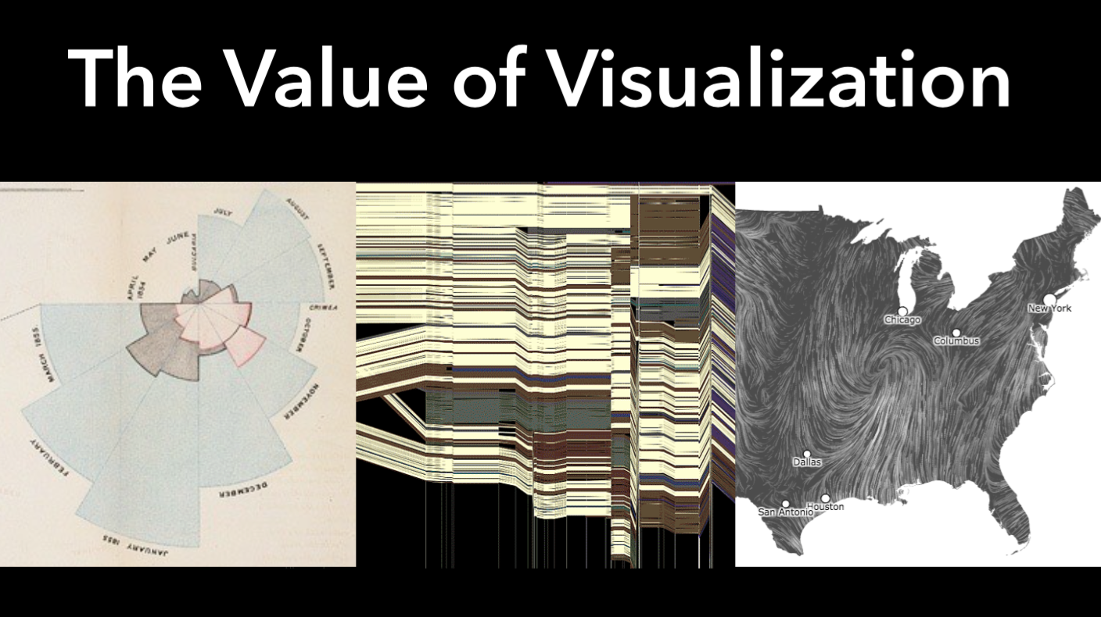

Slide 4
Notes:
Visualizations of GPS data from the Yellow Cab taxis in San Francisco. In these frame-by-frame maps of locations of cabs in the Bay Area, the city pulses like a beating heart.

Slide 7
Notes:
IBM's History Flow tool is a visualization tool for a time-sequence of snapshots of a document in various stages of its creation. The tool supports tracking contributions to the article by different users, and can identify which parts of a document have remained unchanged over the course of many full-document revisions.
The first image below is the diagram for the article on abortion. The black gashes show points where the article has been deleted and replaced with offensive comments. This type of vandalism turns out to be common on controversial articles

Slide 8
Notes:
History Flow - Chocolate
The colorful history flow diagrams take a lengthy edit history and turn it into a picture. The image above, for instance, shows the history of the Wikipedia article on chocolate. What jumps out? The zigzag pattern at the right. It turns out that this is an argument over whether a certain type of chocolate surrealist sculpture exists or not.

Slide 17
Notes:
Animal Locomotion: An Electro-Photographic Investigation of Consecutive Phases of Animal Movement 1872-1885. A portfolio and 85 collotypes by Eadweard Muybridge. Selected by the Keeper of the Royal Academy Schools and purchased in 1889.

Slide 18
Notes:
The sphygmograph (/ˈsfɪɡməˌɡræf, ˌɡrɑːf/^{[1][2]} SFIG-mə-graf) was a mechanical device used to measure blood pressure in the mid-19th century. It was developed in 1854 by German physiologist Karl von Vierordt (1818–1884). It is considered the first external, non-intrusive device used to estimate blood pressure.
The device was a system of levers hooked to a scale-pan in which weights were placed to determine the amount of external pressure needed to stop blood flow in the radial artery. Although the instrument was cumbersome and its measurements imprecise, the basic concept of Vierordt's sphygmograph eventually led to the blood pressure cuff used today.
In 1863, Étienne-Jules Marey (1830–1904), improved the device by making it portable. Also he included a specialized instrument to be placed above the radial artery that was able to magnify pulse waves and record them on paper with an attached pen.

Slide 19
Notes:
When learning about the atom we are shown a diagram with a ball type nucleus of protons (+) and neutrons, with ball like electrons (-) whizzing in orbits round it. Numbers of all vary according to which element. They vary from a simple one of each in hydrogen, to multiple of each in the heavy metals.
Energy beings
This standard diagram is very misleading. These little ball thingy’s actually are not solid at all. Each element in the atom (and there are many other interesting bits and bobs also) are themselves nothing more than pinches of vibrating energy in different combinations. These packets of vibrating energy are called quanta. We are no more than energy beings. So why don’t we bleed into each other and our environment?
Well, the energies within each atom hold the atom, and any combination or molecules, together. Seeming solidity is just a factor of the strength or density of each material’s atomic charge. We can walk though air as it is hardly dense at all. We can sit on iron (or a bullet can pass though us) as it is much denser than we are, so the atomic energy is stronger.
This is the real picture!

Slide 20
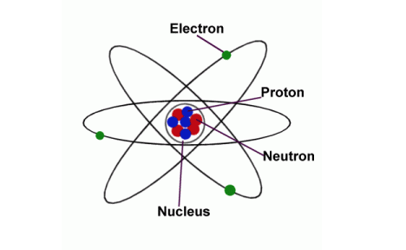
Notes:
When learning about the atom we are shown a diagram with a ball type nucleus of protons (+) and neutrons, with ball like electrons (-) whizzing in orbits round it. Numbers of all vary according to which element. They vary from a simple one of each in hydrogen, to multiple of each in the heavy metals.
Energy beings
This standard diagram is very misleading. These little ball thingy’s actually are not solid at all. Each element in the atom (and there are many other interesting bits and bobs also) are themselves nothing more than pinches of vibrating energy in different combinations. These packets of vibrating energy are called quanta. We are no more than energy beings. So why don’t we bleed into each other and our environment?
Well, the energies within each atom hold the atom, and any combination or molecules, together. Seeming solidity is just a factor of the strength or density of each material’s atomic charge. We can walk though air as it is hardly dense at all. We can sit on iron (or a bullet can pass though us) as it is much denser than we are, so the atomic energy is stronger.
This is the real picture!

Slide 22
Notes:
Ancestry.com now helps you visualize where important events occurred in the lives of your ancestors by placing their events on a map.

Slide 24
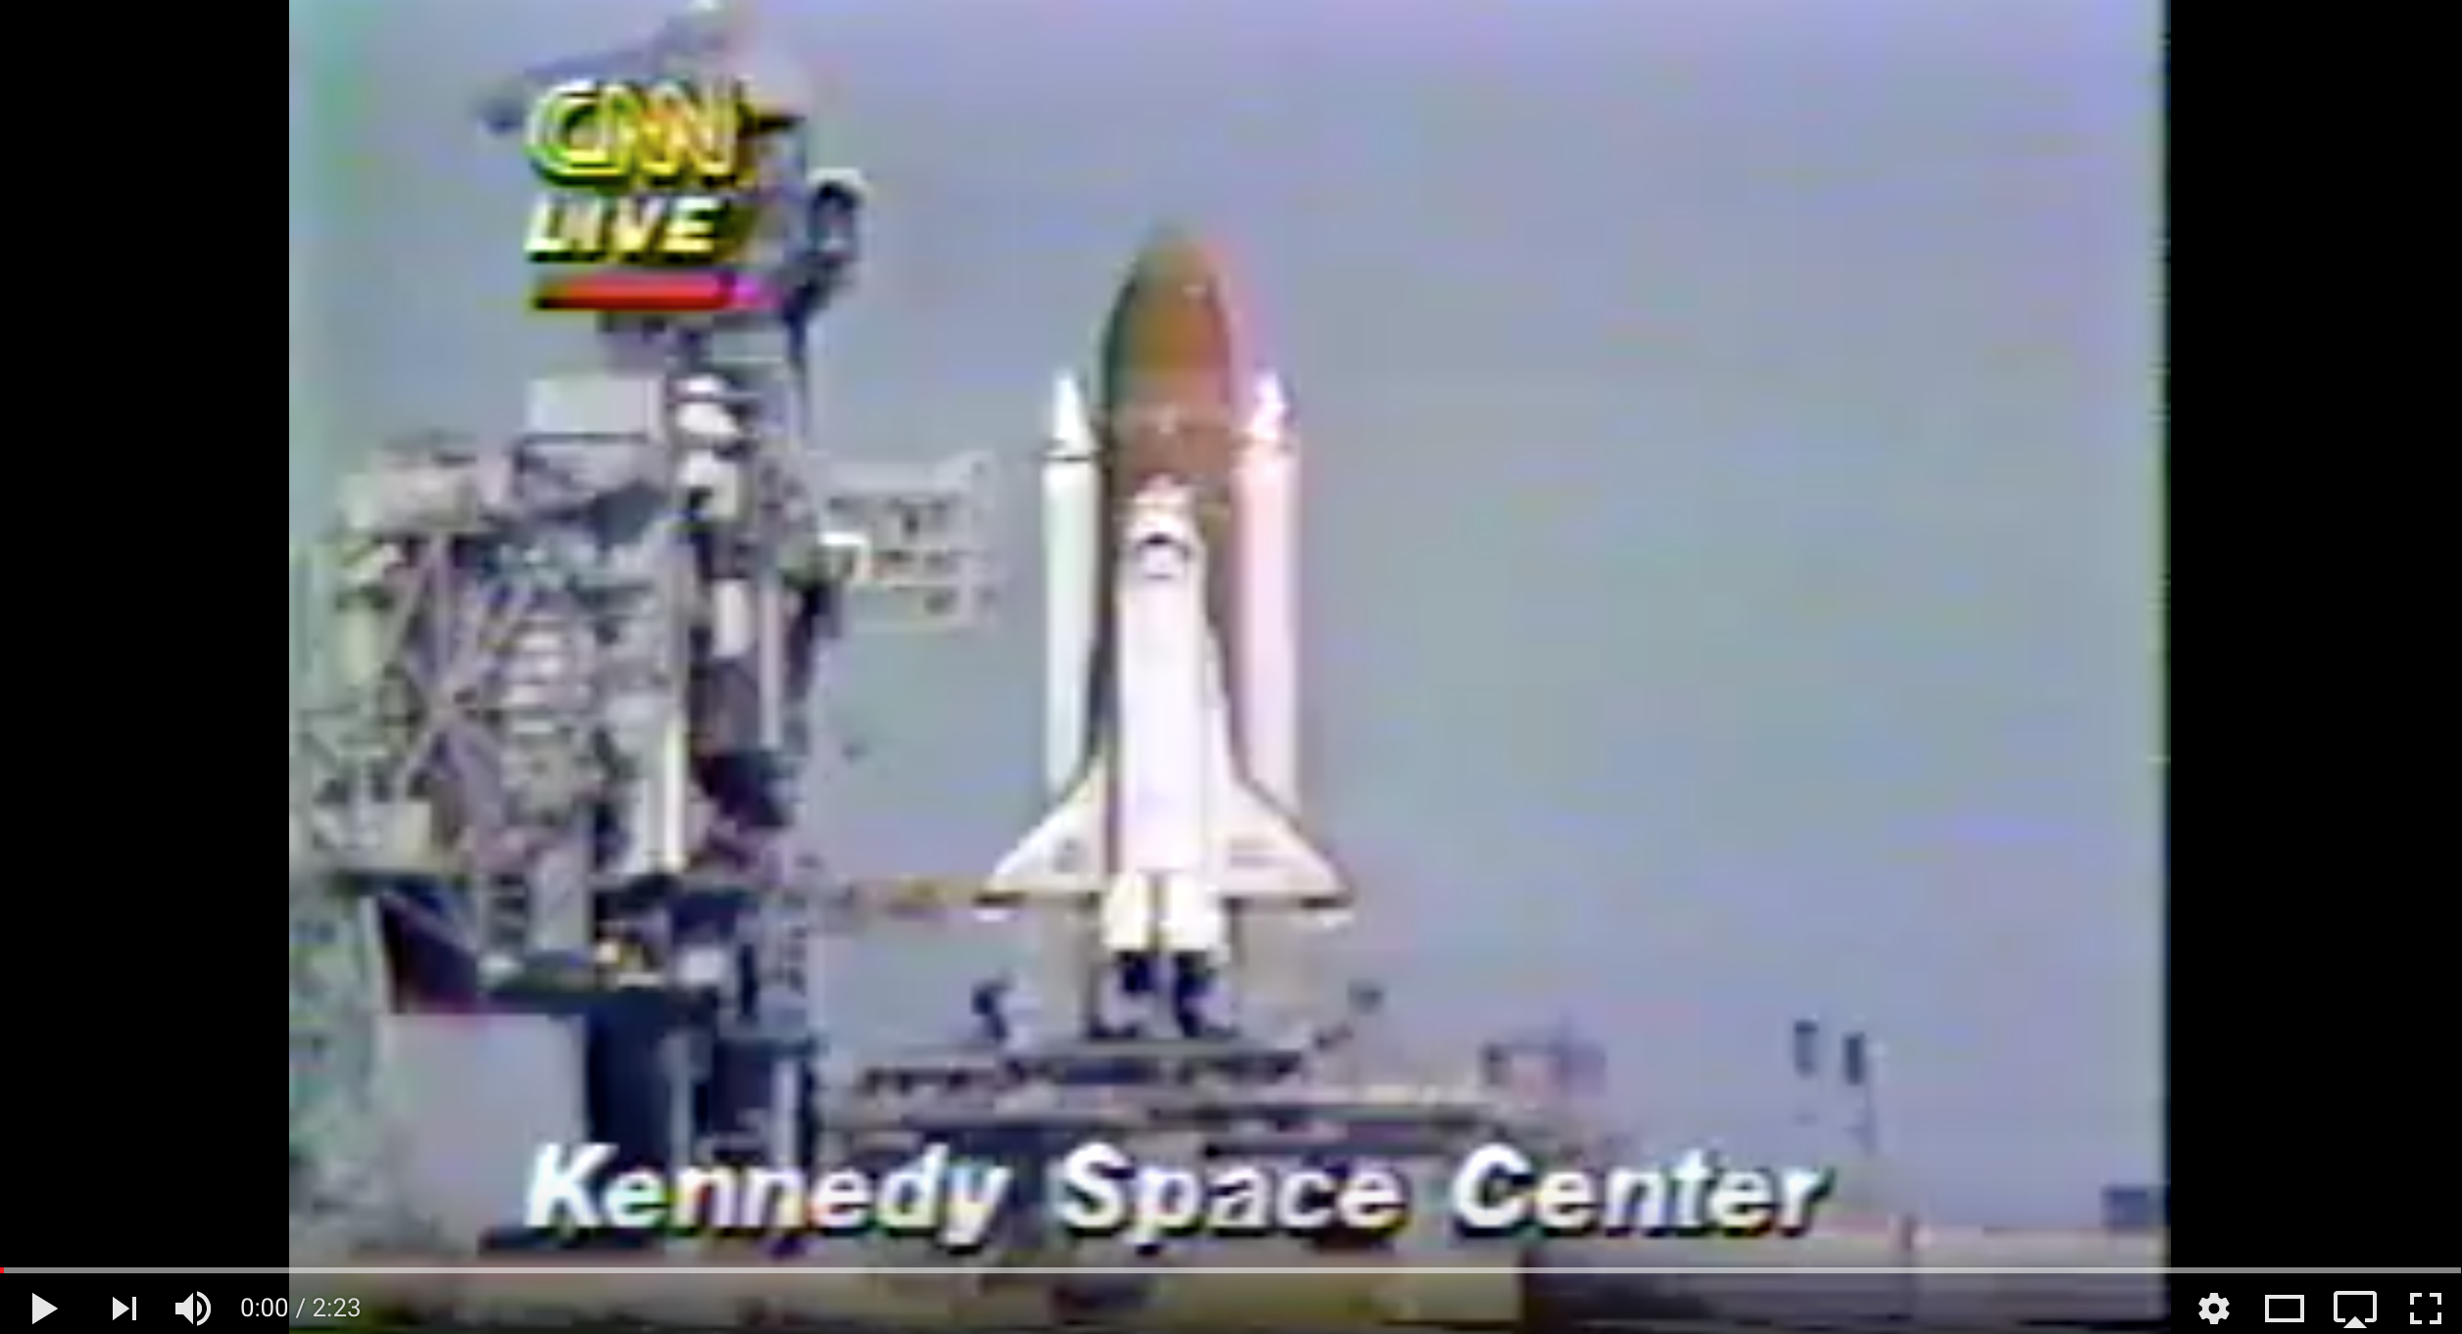
https://www.youtube.com/watch?v=j4JOjcDFtBE

Slide 25
Notes:
The horror of the catastrophe, 26 years ago Saturday, overshadows the story of how it happened. The night before the disaster, scientists at NASA’s rocket engineering contractor Morton Thiokol caught what they thought was a potentially catastrophic fault: the O-rings that sealed the bottoms of the Space Shuttle’s solid rocket boosters would fail in the cold temperatures predicted for next morning’s flight. The problem had been known about for years. In an unusually sobering account, the otherwise light-hearted physicist Richard Feynman would later lambast NASA’s executives for fundamental misunderstandings and hubris. “For a successful technology, reality must take precedence over public relations,” he wrote, “for Nature cannot be fooled.”
That night, the Thiokol engineers tried hard to persuade their superiors to postpone the launch, raising voices and pounding tables. They were ultimately overruled. The launch countdown proceeded as scheduled. On that unusually cold morning, at 11.38 AM, Space Shuttle Challenger broke apart 73 seconds into its flight, instantly killing its seven crew members.
Years later, one unlikely question lingered: could the engineers have been successful at canceling the launch if they had had better slides?

Slide 26
Notes:
Statistician and data visualization legend Edward Tufte argues in his book Visual Explanations that the engineers failed to communicate dangers because the data wasn't presented in an easily digestible form. Witness the two charts engineers used to describe the erosion of O-rings – the cause of the catastrophe – on the morning of the launch:
The typography was sloppy. Unnecessary icons of rockets obscured key numbers. Worst of all, the performance data of the O-rings was arranged by launch date, rather than by the critical factor, temperature. That, says Tufte, made it all but impossible for decision makers to envision that a launch in weather below 66 degrees probably would involve O-ring failure.

Slide 27
Notes:
When Tufte graphs the same data on a chart with a horizontal temperature axis, we get a much more vivid illustration of the correlation between cooler temperatures and an increased chance of damage:
The launch proceeded with an ambient temperature of 36 degrees; the shuttle exploded 73 seconds after liftoff.
Of course, bad slides or bad engineering doesn’t kill people: bad decisions do. Tufte has been taken to task for assigning blame on the engineers’ representation of the data, and as one critic points out, even his revised graph isn’t accurate. Whether or not Tufte’s charges are unfair, the fact remains that information may be our most vital tool, and to know how to use it, we have to understand it first.

Slide 28
Notes:
Dr. John Snow is regarded as one of the founding fathers of modern epidemiology. As London suffered a series of cholera outbreaks during the mid-19th century, Snow theorized that cholera reproduced in the human body and was spread through contaminated water. This contradicted the prevailing theory that diseasses were spread by "miasma" in the air.
London's water supply system consisted of shallow public wells where people could pump their own water to carry home, and about a dozen water utilities that drew water from the Thames to supply a jumble of water lines to more upscale houses. London's sewage system was even more ad hoc: privies emptied into cesspools or cellars more often than directly into sewer pipes. So the pervasive stench of animal and human feces combined with rotting garbage made the miasma theory of disease seem very plausible. Disease was more prevalent in lower-class neighborhoods because they stank more, and because the supposed moral depravity of poor people weakened their constitutions and made them more vulnerable to disease.
The September 1854 cholera outbreak was centered in the Soho district, close to Snow's house. Snow mapped the 13 public wells and all the known cholera deaths around Soho, and noted the spatial clustering of cases around one particular water pump on the southwest corner of the intersection of Broad (now Broadwick) Street and Cambridge (now Lexington) Street. He examined water samples from various wells under a microscope, and confirmed the presence of an unknown bacterium in the Broad Street samples. Despite strong scepticism from the local authorities, he had the pump handle removed from the Broad Street pump and the outbreak quickly subsided.
Snow subsequently published a map of the epidemic to support his theory. A detail fom this map is shown below. The complete map shows the locations of the 13 public wells in the area, and the 578 cholera deaths mapped by home address, marked as black bars stacked perpendicular to the streets.
Some anomalies are worth noting. Although the large workhouse just north of Broad Street housed over 500 paupers, it suffered very few cholera deaths because it had its own well (not shown on the map). Likewise, The workers at the brewery one block east of the Broad Street pump could drink all the beer they wanted; the fermentation killed the cholera bacteria, and none of the brewery workers contracted cholera. Many of the deaths further away from the Broad Street pump were people who walked to work or market on the Broad Street and drank from that well. The water from the Broad Street well reportedly tasted better than water from most of the neighboring wells, particularly the smelly water from the Carnaby Street/Little Marlborough Street well a few blocks to the northeast.

Slide 30
Notes:
Tufte, page 30
The annual review of the weather by The New York Times appears below. It shows daily high and low temperatures for 1980, for a normal year, and for record days, along with cumulative monthly precipitation. Some interesting inferences about average, variation, and rates of change over the seasons can be made visually.
Example: In the middle of February NYC residents can look forward to warming at the rate of about 1.5 degrees per week until July.
The graph tells a story!

Slide 36
Notes:
Through her work as a nurse in the Crimean War, Florence Nightingale was a pioneer in establishing the importance of sanitation in hospitals. She meticulously gathered data on relating death tolls in hospitals to cleanliness, and, because of her novel methods of communicating this data, she was also a pioneer in applied statistics. We explore the work of Nightingale, and in particular focus on her use of certain graphs which, following misreading of her work, are now commonly known as 'coxcombs'.
In March 1854 war broke out between France, Great Britain, Sardinia, and the Ottoman Empire on one side, and Russia on the other side. Most of the fighting in the war occurred on the Crimean Peninsula, in the south of Ukraine, but wounded British troops were shipped across the Black Sea to hospitals in Turkey. The sanitary conditions of these hospitals were awful, and many more people died from diseases than from wounds.
Florence Nightingale arrived in Turkey in October 1854 with a group of women to work as voluntary nurses in the hospitals. They were initially denied entry to the wards, and it was not until the hospitals had reached a critical state in March 1855 that Nightingale and her fellow nurses were allowed proper access to the patients.
Nightingale realised that soldiers were dying needlessly from malnutrition, poor sanitation, and lack of activity. She strove to improve living conditions for the wounded troops, and kept meticulous records of the death toll in the hospitals as evidence of the importance of patient welfare.
After the war, Nightingale returned to Great Britain and continued to fight for better conditions in hospitals. She created graphs, which are often described as roses or coxcombs (although she did not refer to them as such), to highlight the death toll from diseases above the death toll from wounds in the Crimean War. One of her original graphs is shown in the following image.

Slide 40
Notes:
Jacques Bertin (27 July 1918 – 3 May 2010^{[1]}) was a French cartographer and theorist, known from his book Semiologie Graphique (Semiology of Graphics), published in 1967. This monumental work, based on his experience as a cartographer and geographer, represents the first and widest intent to provide a theoretical foundation to Information Visualization.^{[2]}

Slide 44


Slide 46
Notes:
Steven's Power Law is a psychophysical concept that states the the strength of a physical stimulus is proportional to the sensation that is perceived by the recipient. The magnitude of the sensation increases in a predictable and proportional manner to the strength of the stimulus. This can be measured using a variety of stimuli including light brightness, auditory volume, vibration, temperature, taste, and smell. Steven's Power Law essentially states that as a stimulus increases in magnitude (a room growing increasingly warmer) it will increase the sensation of the stimulus proportionally (you're not cold any more, you're getting a little warm and remove a sweater, you start sweating and growing uncomfortable).

Slide 55
Iowa Pig Visualization
Must be hand drawn (The entire visualization!)
8.5X11 Sheet of paper
Must represent the data from the 2012 Census
We will critique and vote as a class

